Slide 1

Understanding the meaning and implications of Linking Level Article and Linking Level Journal
Managing
Electronic
Resources
Yoel Kortick
Senior Librarian

Slide 2

Agenda
The question
The high level answer
An example with Linking Level "Journal"
An example with Linking Level "Article"
A note about the Context Object and Open URL

Slide 3
The question

Slide 4
The question
How come in Primo after I find an article in CDI and click "Available Online" …
  Sometimes the link goes directly to the article
  Sometimes the link goes to the journal (not directly to the article) and then I must search the journal for the specific article

Slide 5
The high level answer

Slide 6
The high level answer
Whether or not the link goes directly to the journal or directly to the article depends on the "Linking Level" of the electronic collection to which the portfolio of the journal (which contains the article) belongs.
  If the "Linking Level" is "Journal" then the link will go to the journal.
  If the "Linking Level" is "Article" then the link will attempt go to directly to the article. We say "attempt to" go to directly to the article because it depends on the metadata being sent in the open URL .

Slide 7
An example with Linking Level "Journal"

Slide 8
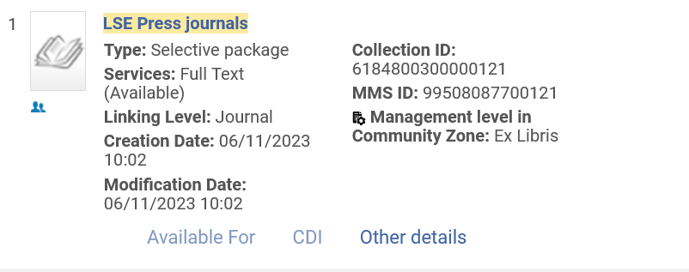
An example with Linking Level "Journal"
Electronic collection "LSE Press journals" is "Linking Level: Journal"

Slide 9
An example with Linking Level "Journal"
Regarding the "Linking Level: Journal": we can see (on the next slide) in the "Linking" tab of the Electronic Service Editor for this electronic collection that Parser is "Bulk::BULK".
That means the vender (from whom the electronic resources of the collection are accessed) is not using any special kind of program to take the metadata and attempt to resolve directly to the article. The link will go directly to the journal.

Slide 10
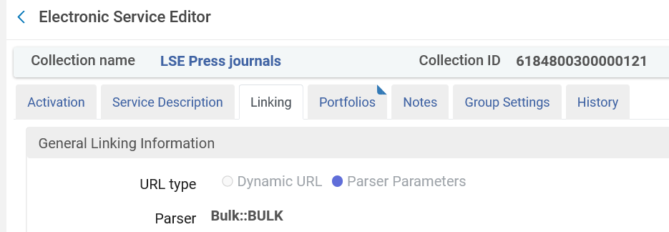
An example with Linking Level "Journal"

Slide 11
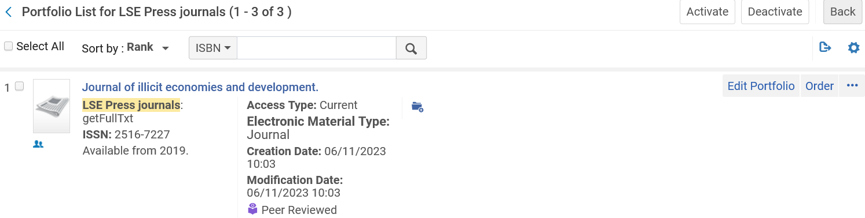
An example with Linking Level "Journal"
Electronic Collection "LSE Press journals" includes portfolio "Journal of illicit economies and development".

Slide 12
An example with Linking Level "Journal"
Article "Selling the Priceless Mushroom: A History of Psilocybin Mushroom Trade in the Sierra Mazateca" is in "Journal of illicit economies and development"(2022, Vol.4 (2), p.177-190)
We will search CDI via Primo VE for this article, and then click "Available Online"

Slide 13
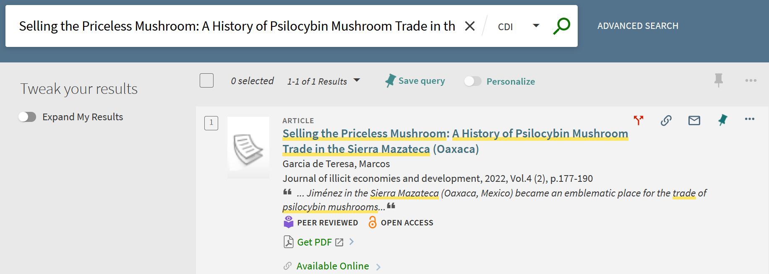
An example with Linking Level "Journal"

Slide 14
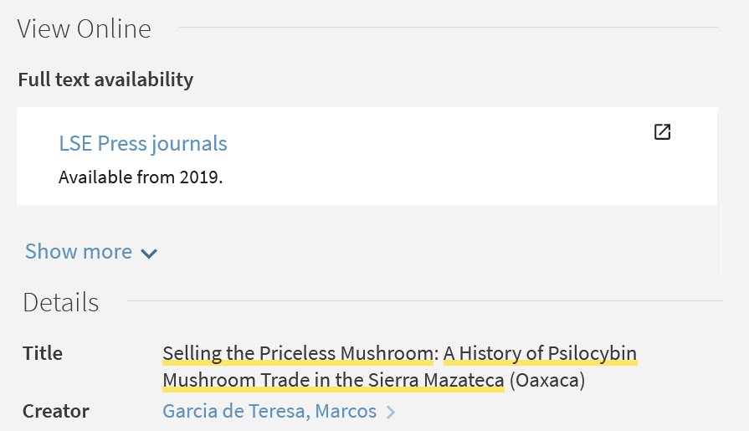
An example with Linking Level "Journal"
Now we will click the link to "LSE Press Journals"

Slide 15
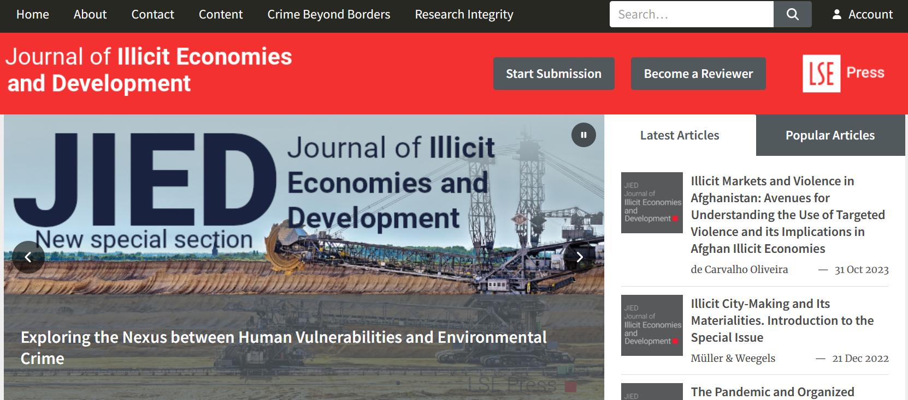
An example with Linking Level "Journal"
We arrive to the Journal (not to the article)

Slide 16
An example with Linking Level "Article"

Slide 17
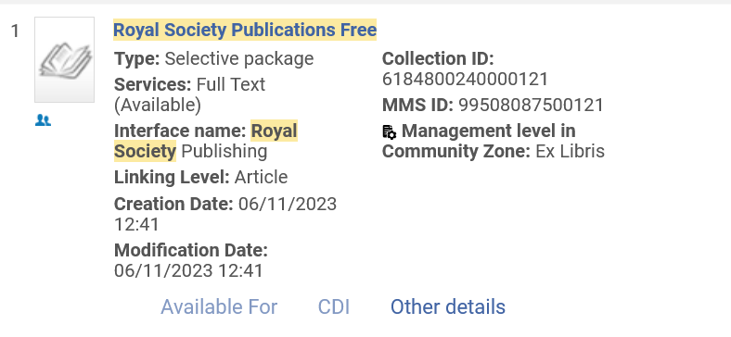
An example with Linking Level "Article"
Electronic collection "Royal Society Publications Free" is "Linking Level: Article"

Slide 18
An example with Linking Level "Article"
Regarding the "Linking Level: Article": we can see (on the next slide) in the "Linking" tab of the Electronic Service Editor for this electronic collection that Parser is "ATYPON::AFS".
That means the vender (from whom the electronic resources of the collection are accessed) is using a program (called ATYPON::AFS) to take the metadata and attempt to resolve directly to the article.

Slide 19
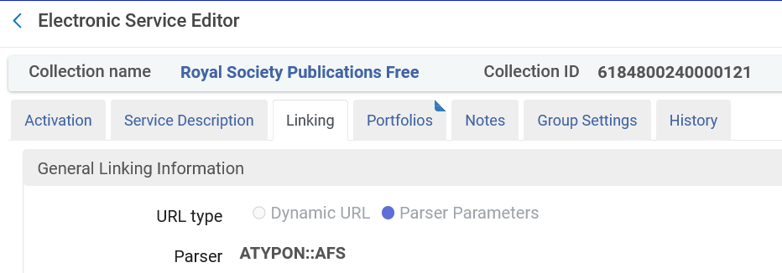
An example with Linking Level "Article"

Slide 20
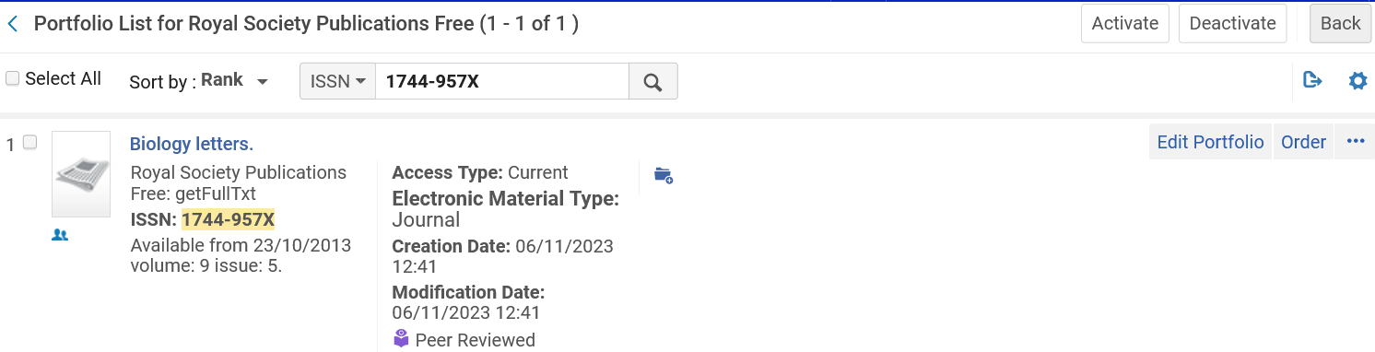
An example with Linking Level "Article"
Electronic Collection "Royal Society Publications Free" includes portfolio "Biology Letters".

Slide 21
An example with Linking Level "Article"
Article "Camouflage using three-dimensional surface disruption" is in "Biology Letters"((2005), 2023, Vol.19 (8))
We will search CDI via Primo VE for this article, and then click "Available Online"

Slide 22
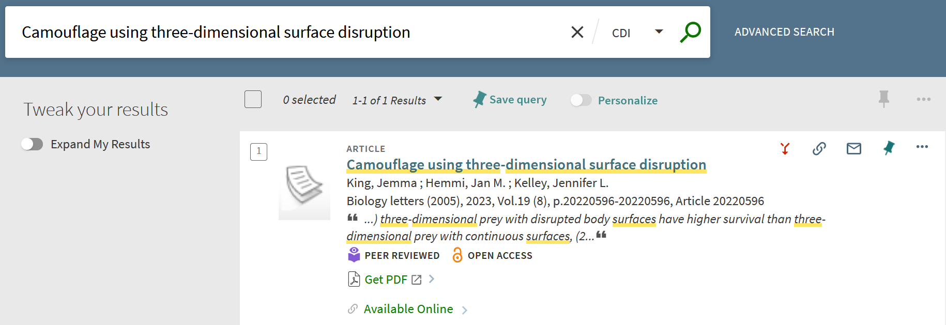
An example with Linking Level "Article"

Slide 23
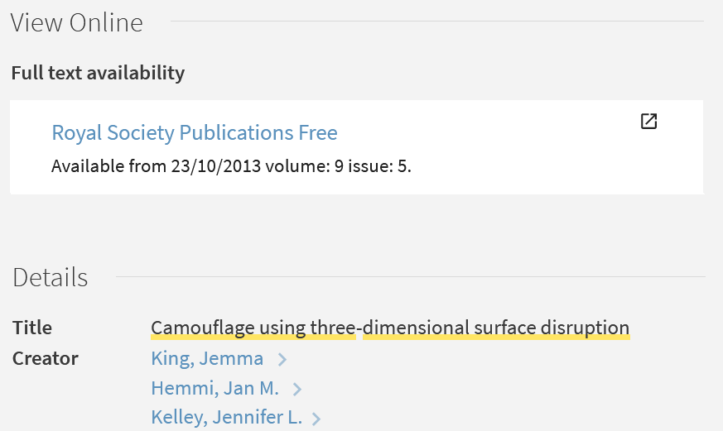
An example with Linking Level "Article"
Now we will click the link to "Royal Society Publications Free"

Slide 24
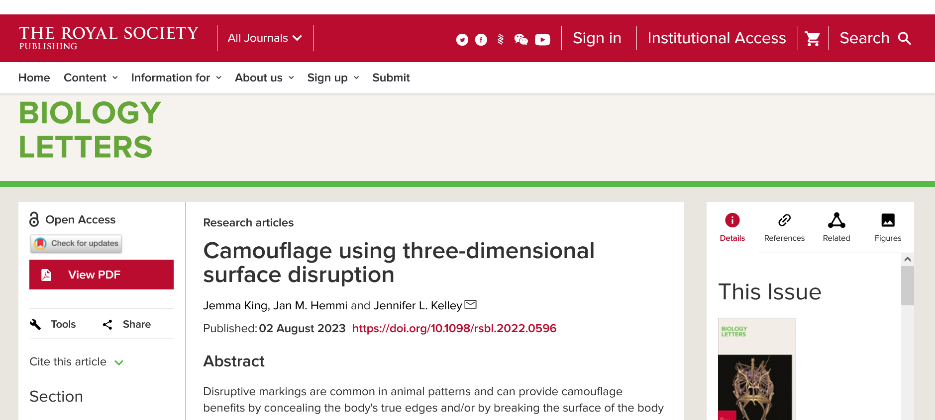
An example with Linking Level "Article"
We arrive directly to the article (not to the level of the Journal)

Slide 25
A note about the Context Object and Open URL

Slide 26
A note about the Context Object and Open URL
The following is "general information" for those interested and not mandatory for understanding the "Linking Level" which we have thus far demonstrated.
See also Alma Link Resolver Workflow

Slide 27
A note about the Context Object and Open URL
When we clicked "Available Online" and then "Royal Society Publications Free" the program from the vendor "ATYPON::AFS" was used to attempt to link directly to the article.
This is the program which we saw in the Linking Tab of the "Electronic Service Editor".

Slide 28
A note about the Context Object and Open URL
The attempt to link directly to the article level is done using the metadata supplied after clicking (in this case) "Royal Society Publications Free".
Sometimes the attempt to link directly to the article level fails, and this is often because the metadata which is supplied for the OpenURL is not sufficient to arrive directly to the article.

Slide 29
A note about the Context Object and Open URL
It is possible to view the metadata which is supplied for the OpenURL.
This can be done by adding &displayCTO=true to the end of the URL of the browser after clicking "Available Online".
For example, we will add the text in yellow:
https://exldeveu00.primo.exlibrisgroup.com/discovery/fulldisplay?docid=cdi_crossref_primary_10_1098_rsbl_2022_0596&context=PC&vid=EXLDEV1_INST:Alma&lang=en&search_scope=CentralIndex&adaptor=Primo Central&tab=CentralIndex&query=any,contains,Camouflage using three-dimensional surface disruption&offset=0&displayCTO=true

Slide 30
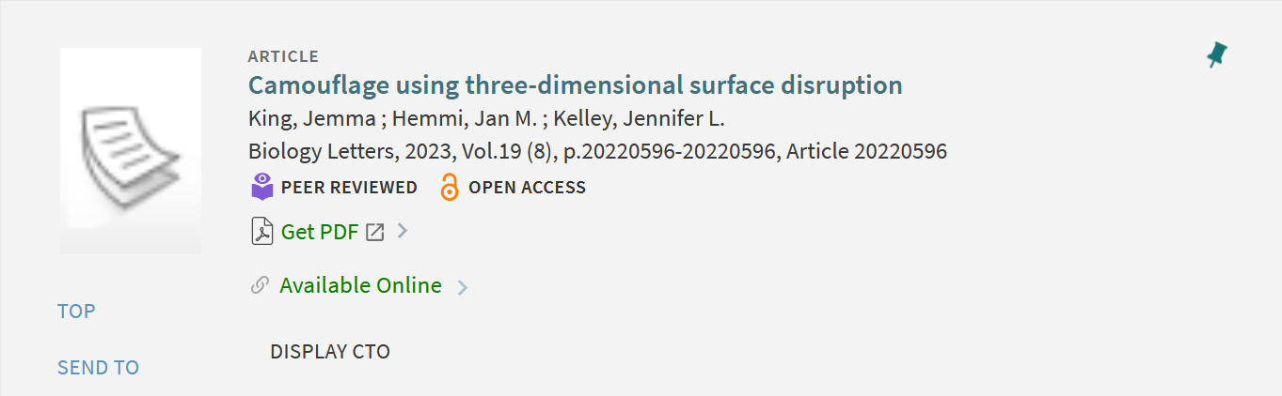
A note about the Context Object and Open URL
Now we have a button "Display CTO"
We will click this and on the next slide see a partial screenshot of the results

Slide 31
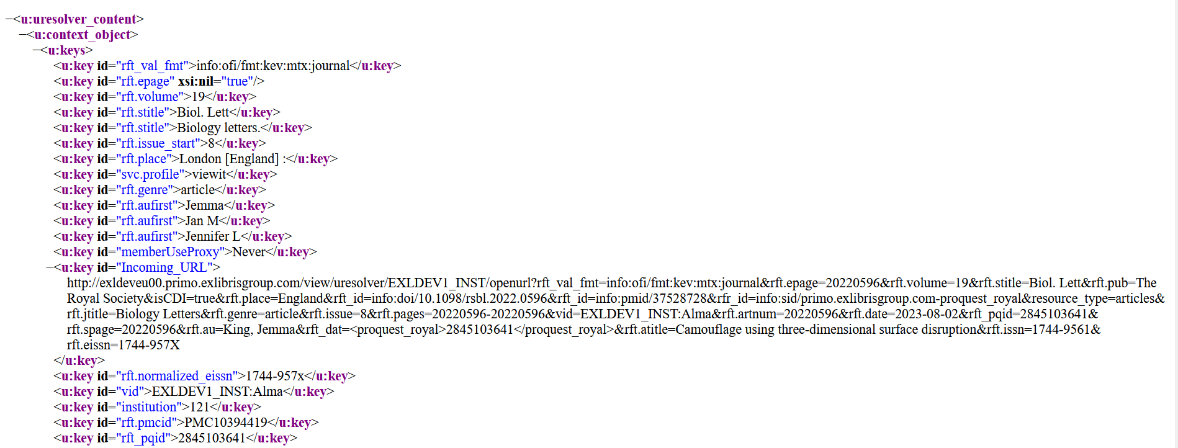
A note about the Context Object and Open URL
This is the information which is used to attempt to "resolve" the URL to the article level.

Slide 32
xxx@exlibrisgroup.com

